Slide 1

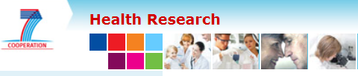
Introducing the CarTarDis project
Health call 2013
Cardiovascular Target Discovery
www.cartardis.eu
Dennie Tempel
UMCU, Utrecht, 7 April 2017

Slide 2

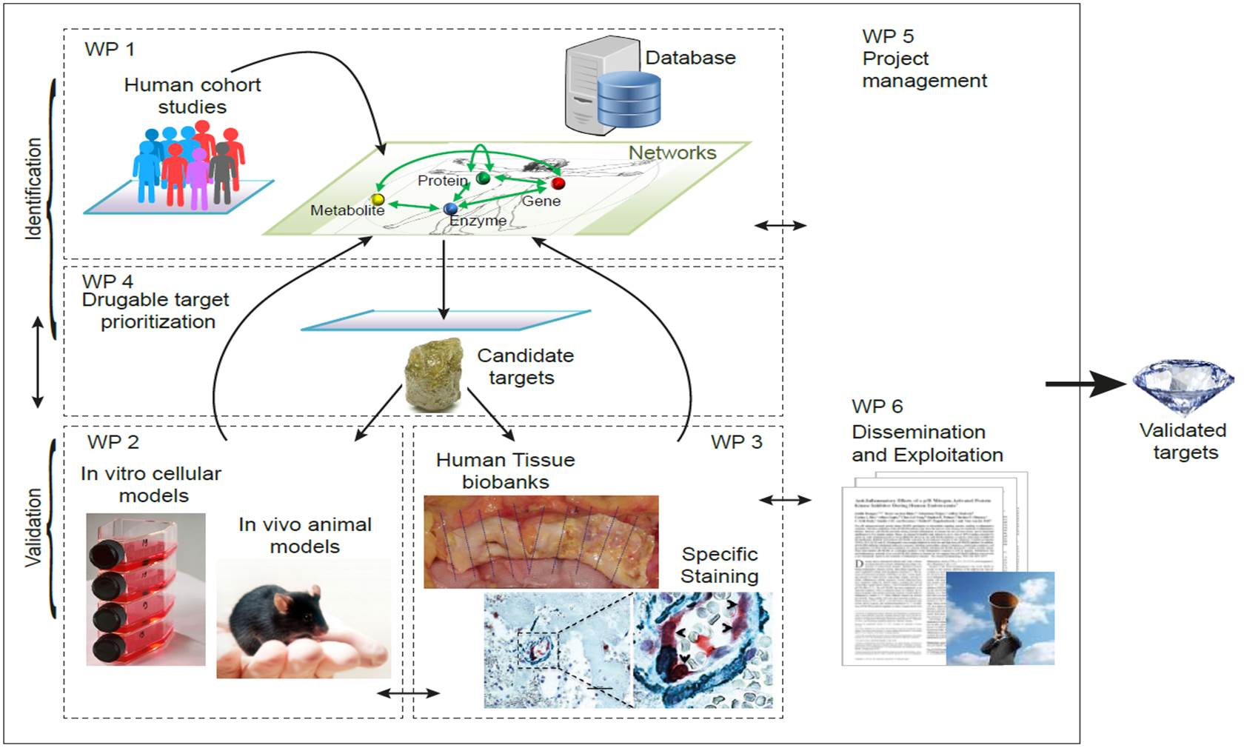









Target identification & selection process
CarTarDis
1. Generate a comprehensive candidate target database
GWAS, literature, proprietary
2. Review all candidate targets
Automatic scoring
Expert review
3. Rank targets (following 5R’s)
1. Drugability
2. Novelty
3. Omics/genetics
4. Feasibility (within CarTarDis)
5. Pathways (expertise within CarTarDis)
4. Select shortlist of candidate targets for validation

Slide 3




Oncostatin M
Daniëlle van Keulen

Slide 4
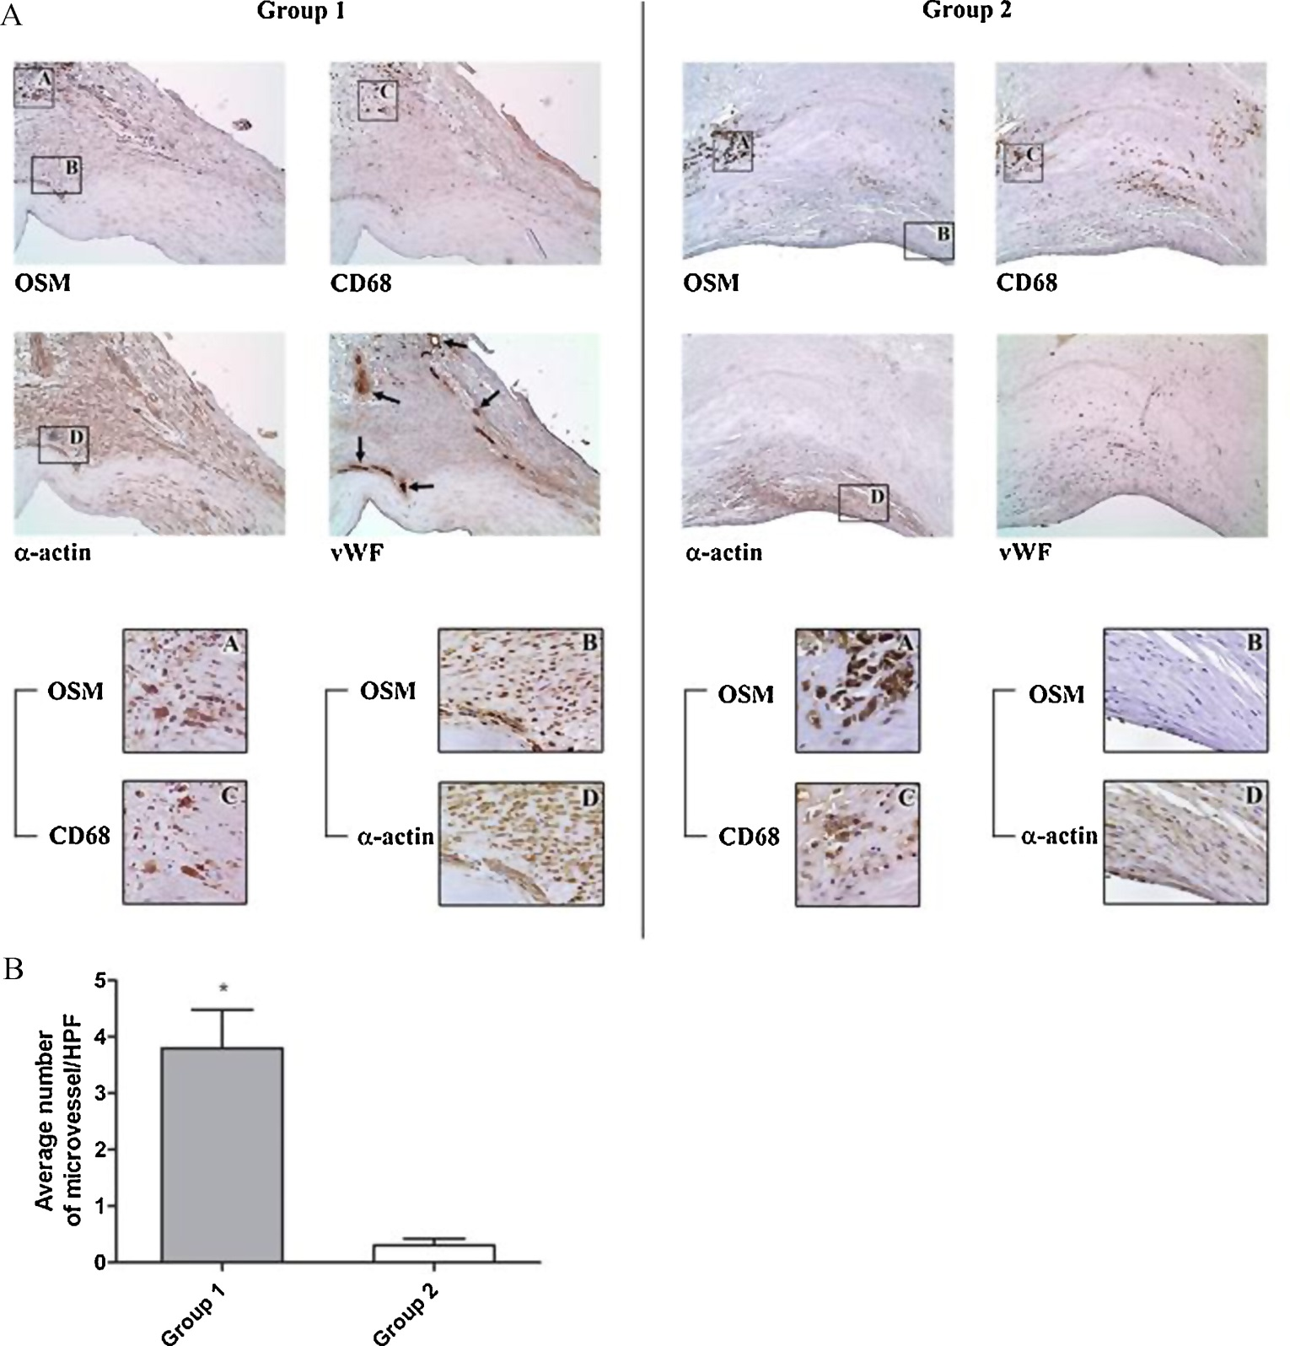

Background Oncostatin M
Interleukin-6 family¹
Serum OSM levels are upregulated in patients with coronary artery disease²
OSM is expressed in human atherosclerotic lesions³
Secreted by activated monocytes and neutrophils^{1,4}
OSM induces smooth muscle cell proliferation⁵
OSM induces angiogenesis⁶
Endothelial cells are high expressors of OSM receptors⁷
¹ Vasse M et al., Arterioscler Thromb Vasc Biol. 1999 Aug;19(8):1835-42
² Li X et al., Clin Lab. 2014;60(1):113-8
³ Albasanz-Puig A et al., Atherosclerosis. 2011 Jun;216(2):292-8
⁴ Richards CD, ISRN Inflamm. 2013 Dec 8;2013:512103
⁵ Demyanets S, et al., Am J Physiol Heart Circ Physiol. 2007 Sep;293(3):H1962-8
⁶ Fearon U et al., Arthritis Rheum. 2006 Oct;54(10):3152-62
⁷ Brown TJ et al., J Immunol. 1991 Oct 1;147(7):2175-80
CarTarDis

Slide 5
Does OSM induce endothelial activation?
CarTarDis

Slide 6
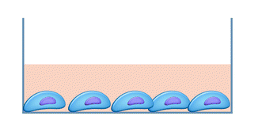
Does OSM induce endothelial activation?
OSM
HUVECs
Human umbilical vein endothelial cells
HAECs
Human Aortic endothelial cells
HMECs
Human microvascular endothelial cells
CarTarDis

Slide 7
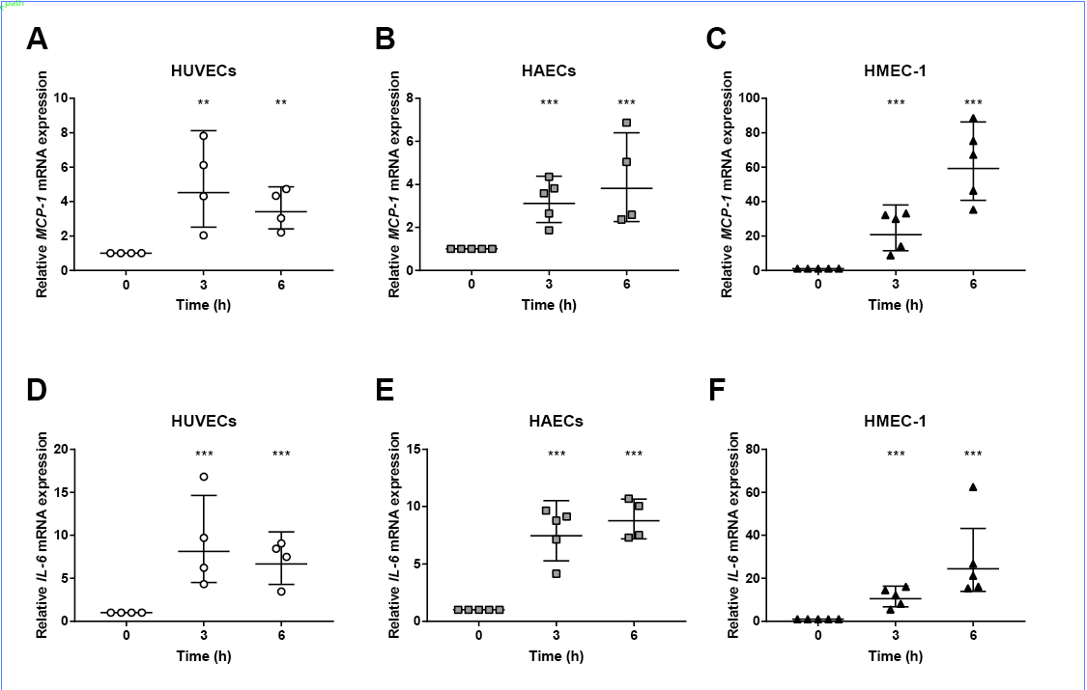
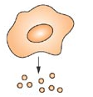
OSM increases MCP-1 and IL-6 mRNA expression
CarTarDis
Cytokine
release

Slide 8
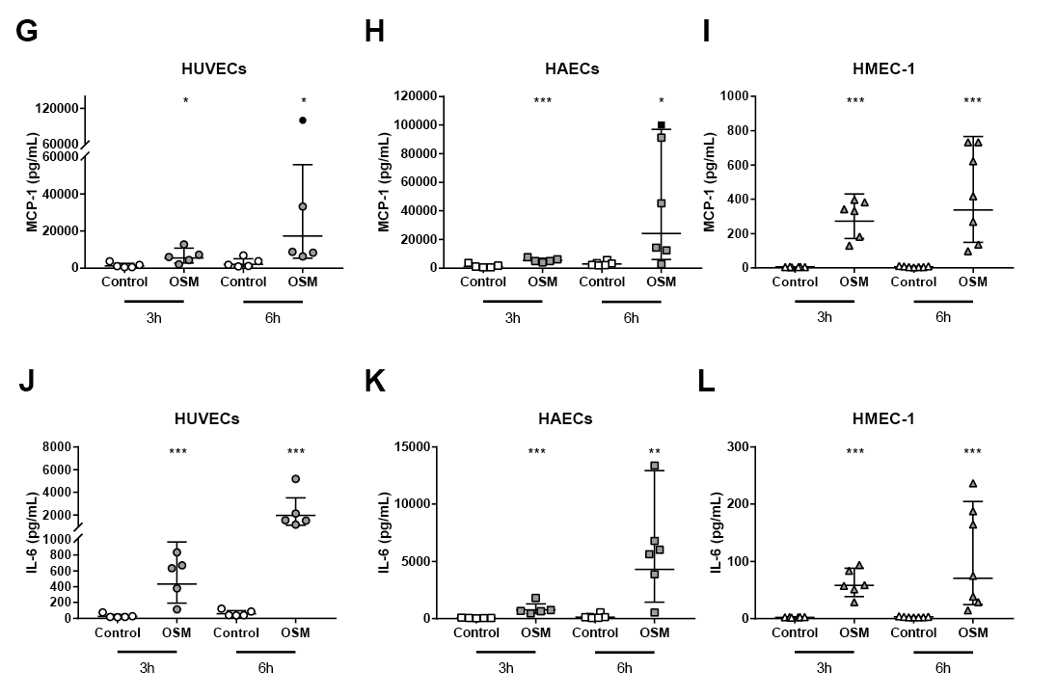
OSM increases MCP-1 and IL-6 protein release
CarTarDis
Cytokine
release

Slide 9
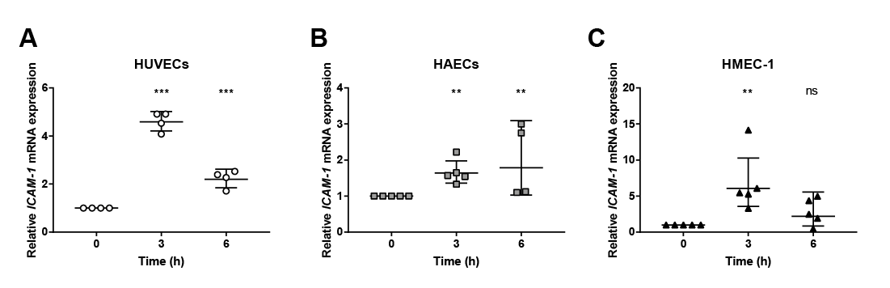

OSM increases ICAM-1 mRNA expression
CarTarDis
Expression adhesion molecules

Slide 10
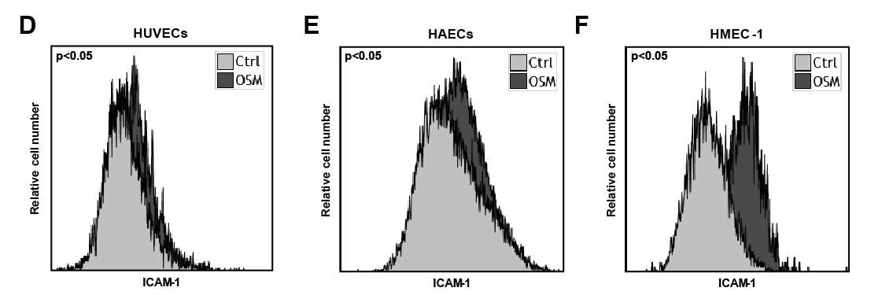
OSM increases ICAM-1 membrane expression
CarTarDis
Expression adhesion molecules

Slide 11
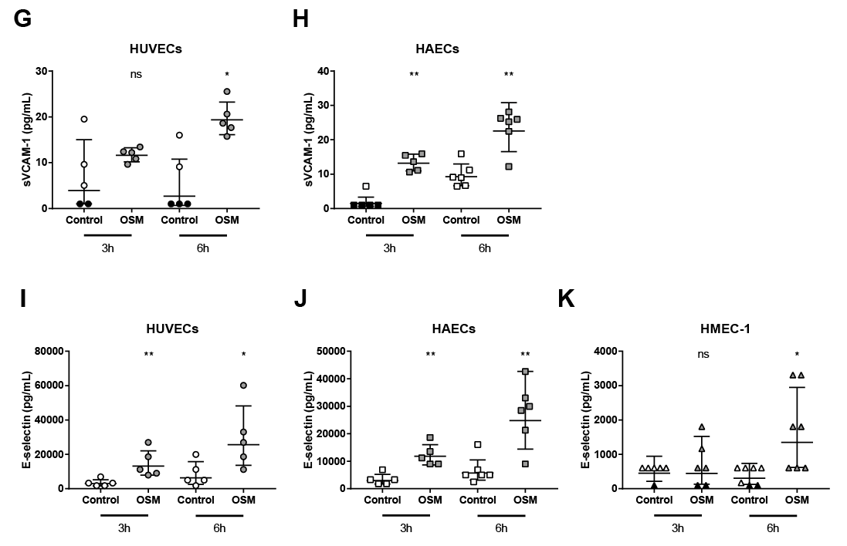
OSM increases sVCAM-1 and sE-selectin shedding
CarTarDis
Expression adhesion molecules

Slide 12
Which pathway and which receptor is involved in OSM induced endothelial activation?
CarTarDis

Slide 13
OSM induces STAT1 and STAT 3 phosphorylation

Slide 14
siRNA knockdown of the OSM receptors

Slide 15
Does OSM induce endothelial activation in vivo?
CarTarDis

Slide 16
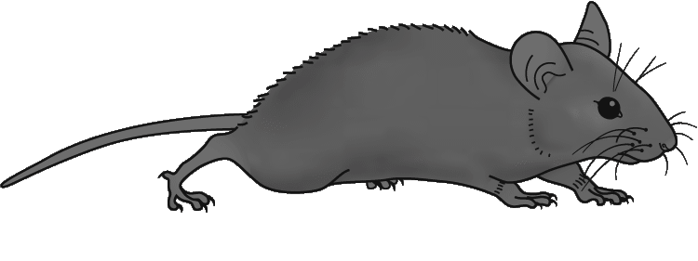
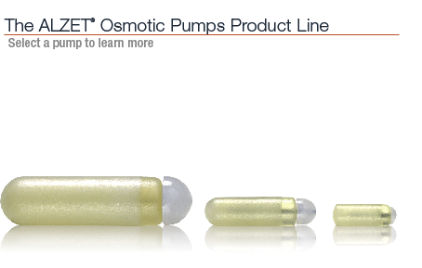
Does OSM induce endothelial activation in vivo?
T = -3 weeks
T = 0 weeks
T = 3 weeks
Group 1
PBS
Group 2
1 µg/kg/day
Group 3
3 µg/kg/day
Group 4
10 µg/kg/day
Start cholesterol diet
Sacrifice animals
Heart
Carotid arteries
Aorta
Kidneys
Lungs
Liver
Spleen
White adipose tissue
Brown adipose tissue
Placement osmotic pump OSM/ PBS
APOE*3Leiden.CETP
CarTarDis

Slide 17
OSM has no influence on bodyweight or food intake
CarTarDis

Slide 18
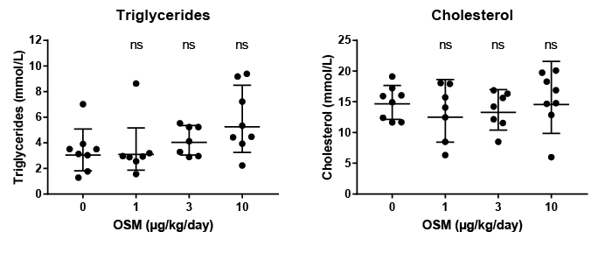
OSM has no influence on triglycerides or cholesterol
CarTarDis

Slide 19
OSM increases plasma levels of inflammatory markers
CarTarDis

Slide 20
OSM enhances Il-6 mRNA expression
CarTarDis

Slide 21
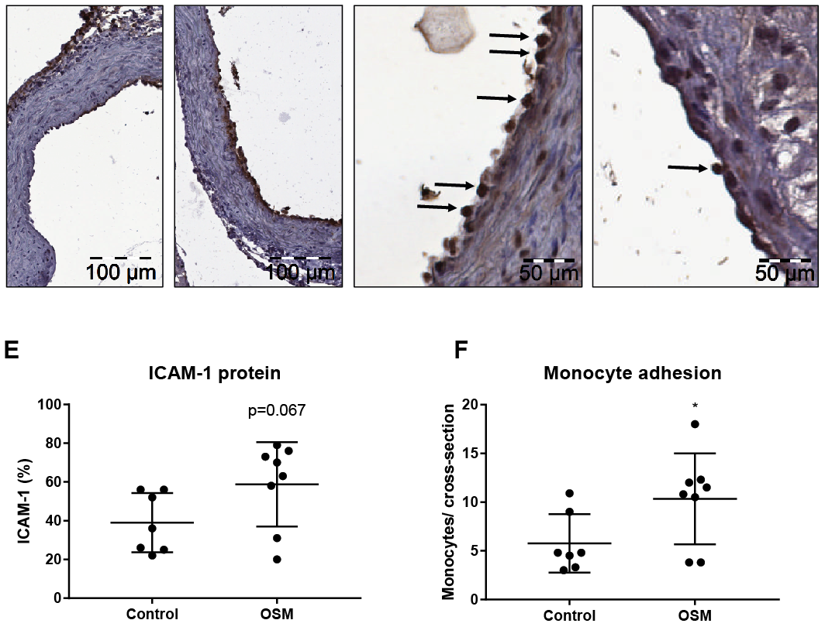
OSM enhances ICAM-1 protein expression
CarTarDis

Slide 22
OSM enhances monocyte adhesion
CarTarDis

Slide 23
OSM induces endothelial activation in vivo
Plasma E-selectin levels
Plasma MCP-1 levels
Aortic Il-6 expression
Aortic Icam-1 expression
Aortic root VCAM-1 expression
Aortic root monocyte adhesion
CarTarDis

Slide 24
Does OSM enhance atherosclerosis development?
CarTarDis

Slide 25
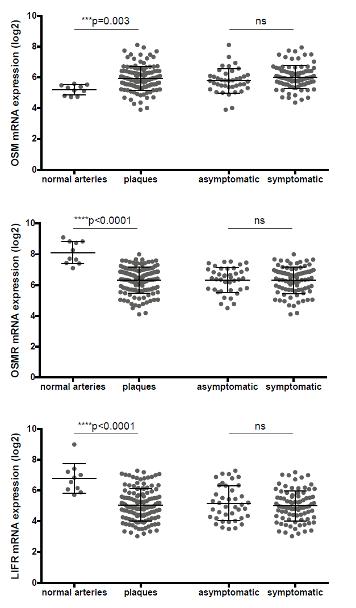
OSM, OSMR and LIFR mRNA expression is present in human atherosclerotic plaques.

Slide 26
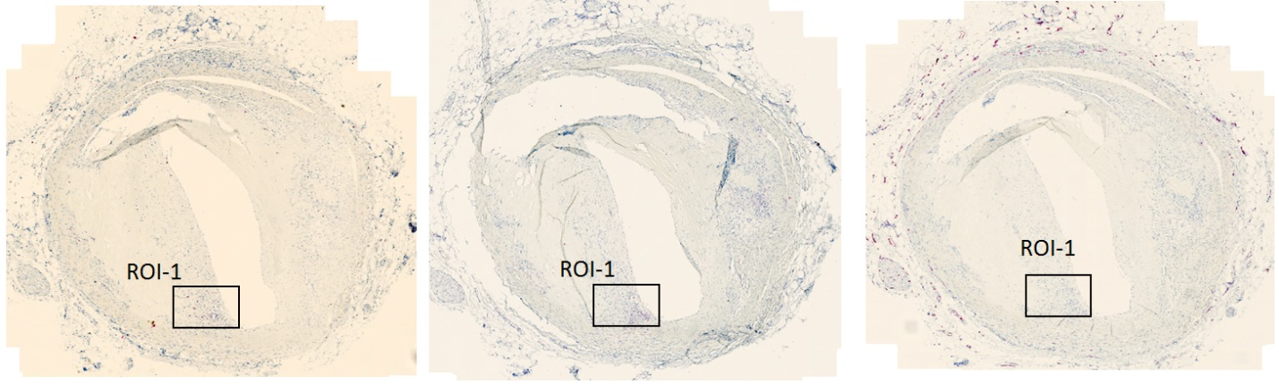
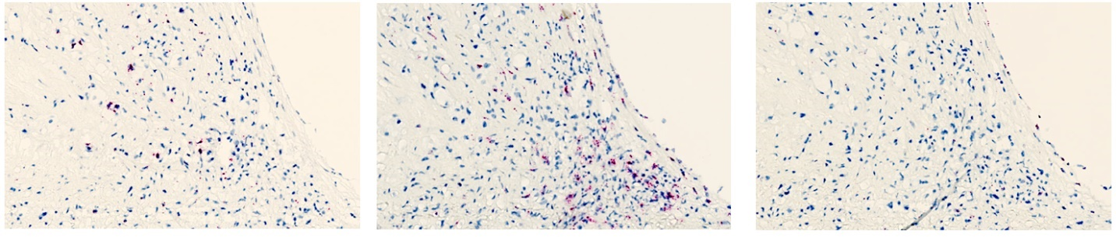
OSM, OSMR and LIFR mRNA expression is present in human atherosclerotic plaques.
OSM-mRNA
OSMR-mRNA
LIFR-mRNA

Slide 27
OSM study
-3 weeks
0 weeks
5.5 weeks
11 weeks
16 weeks
Group 1
PBS
Group 2
10 µg/kg/day
Group 3
30 µg/kg/day
Group 4
30 µg/kg/day
PBS
Start cholesterol diet
Sacrifice animals
for analysis
Placement osmotic pump OSM/ PBS

Slide 28
Bodyweight

Slide 29
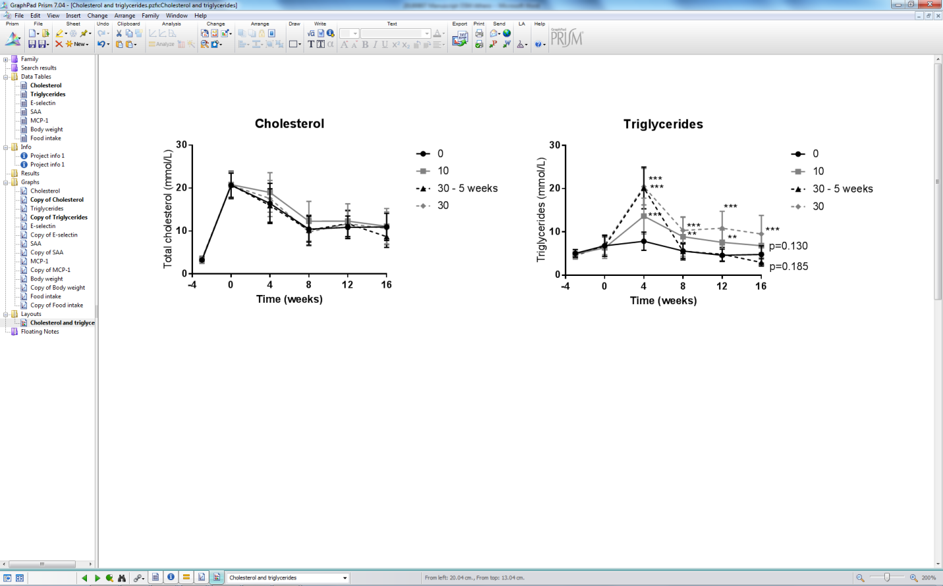
Plasma cholesterol & triglycerides

Slide 30
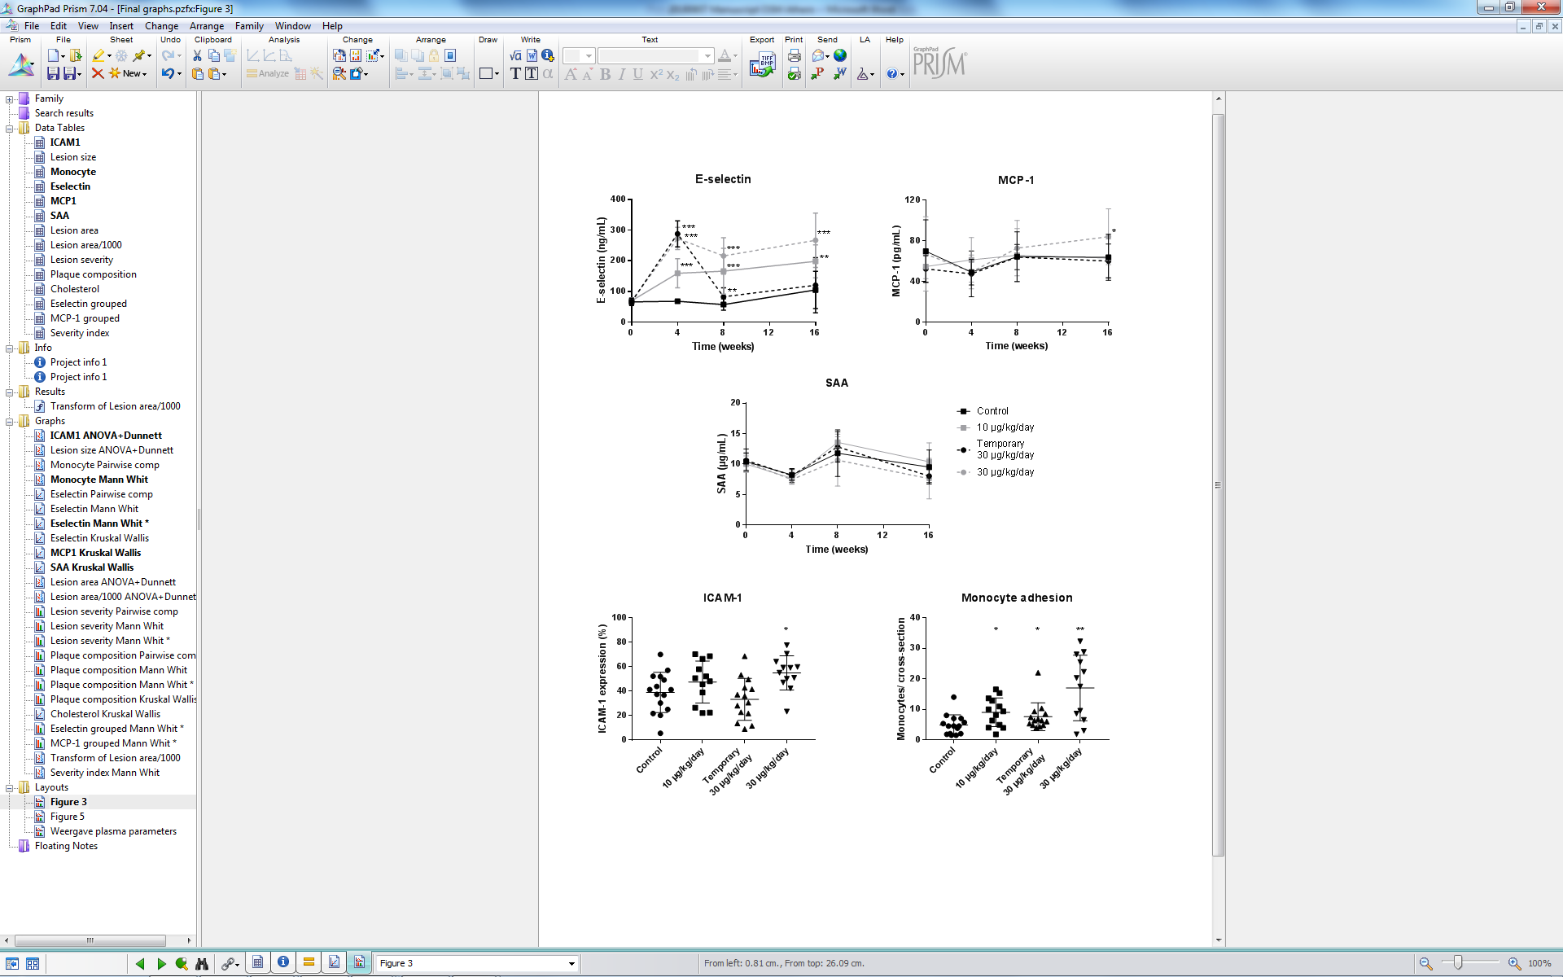
Plasma inflammatory markers

Slide 31
Aortic root area

Slide 32
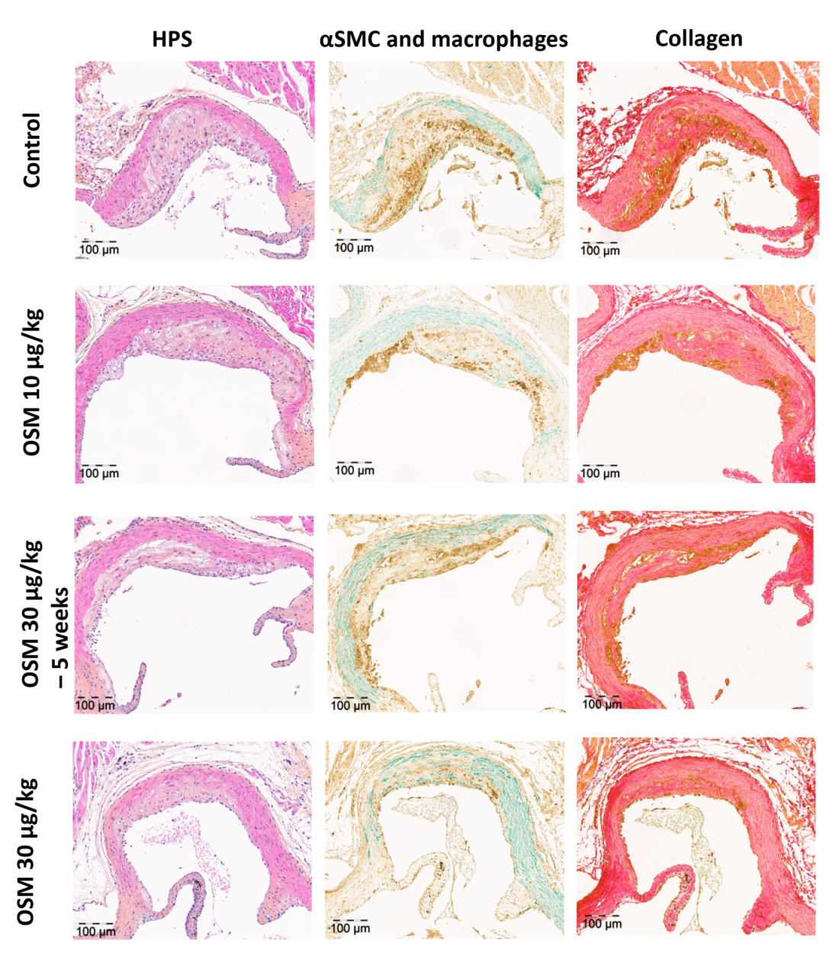
Staining aortic root area

Slide 33
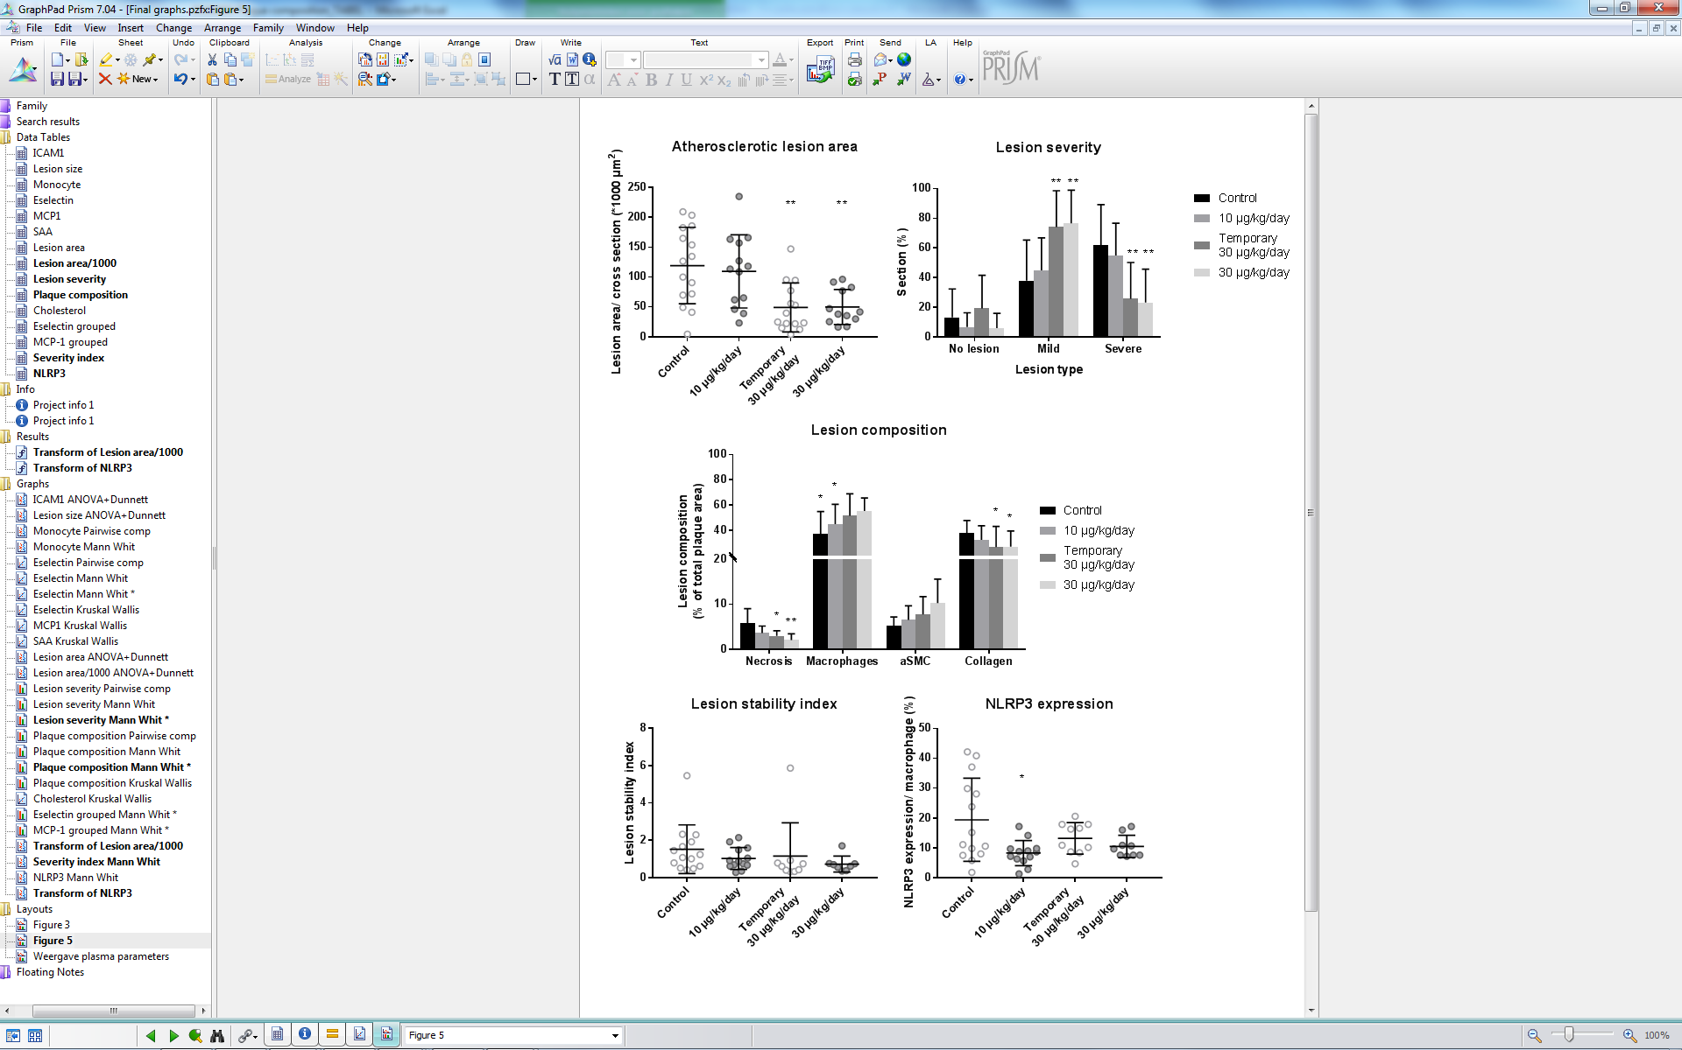
Lesion area, severity & composition

Slide 34
Lesion stability & NLRP3

Slide 35
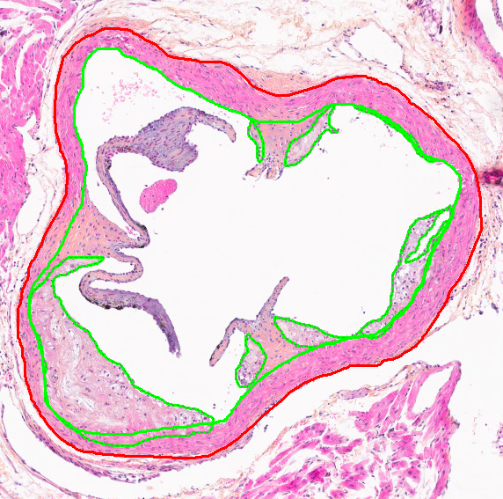
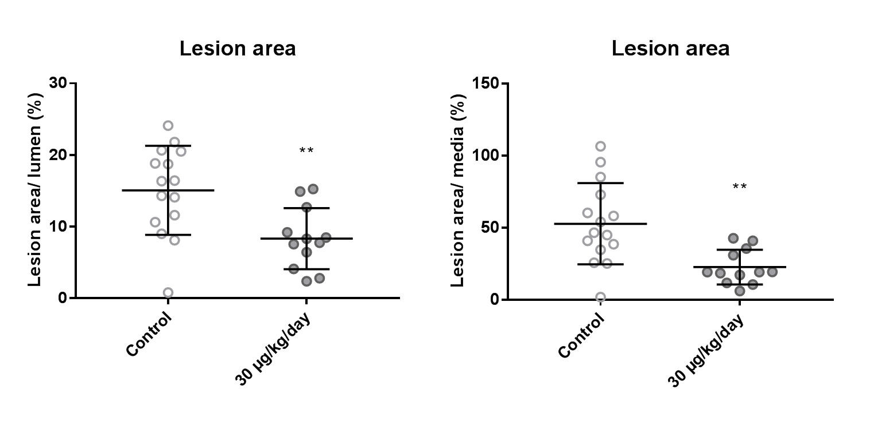
Lesion area/ lumen and media

Slide 36
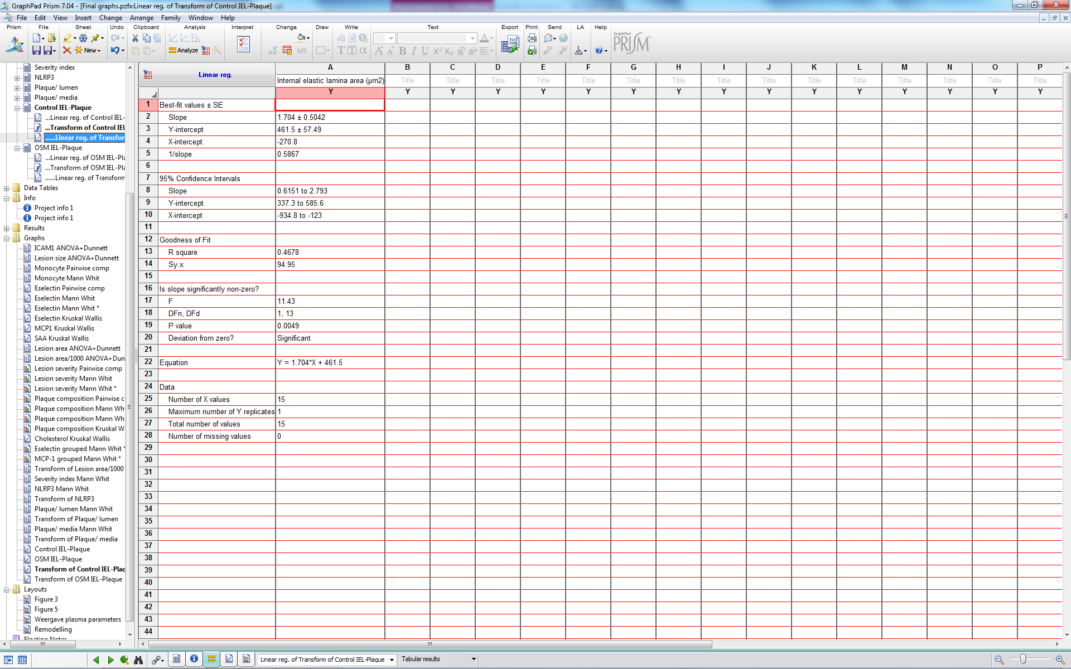
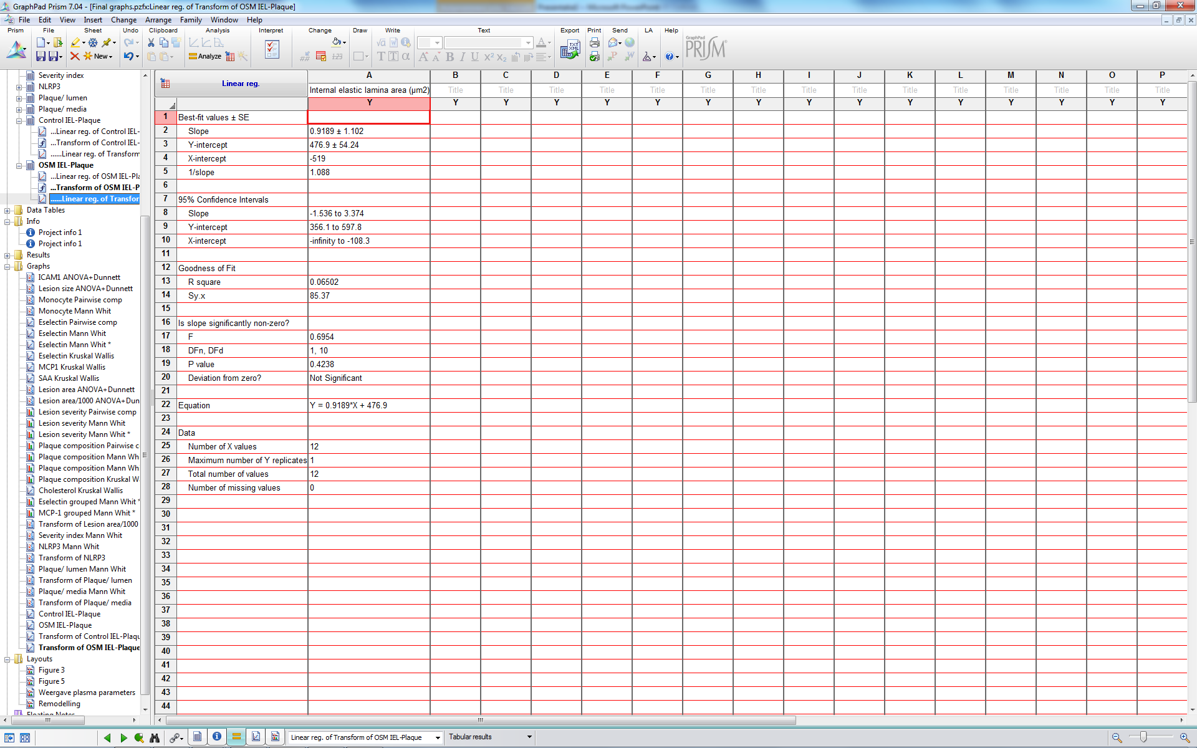

Slide 37
Does OSM enhance fibrosis development?
CarTarDis

Slide 38
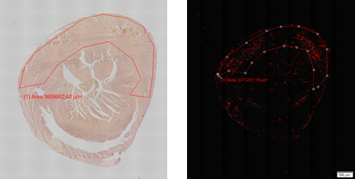
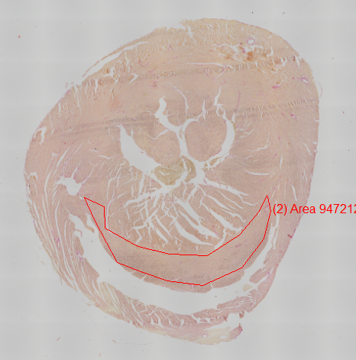
Picrosirius red myocardium
Mann Whitney U p=0.102 p=0.042 p=0.345

Slide 39
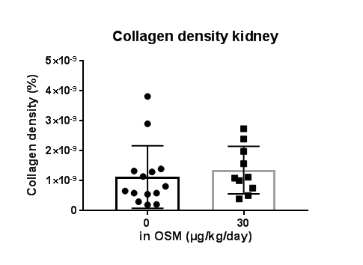
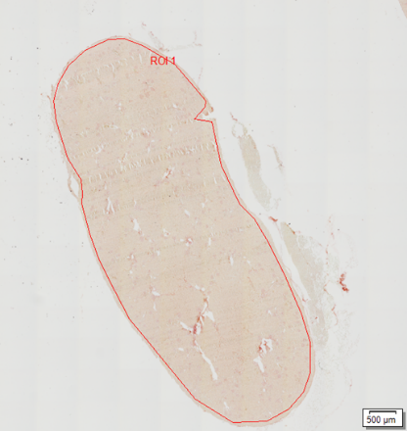
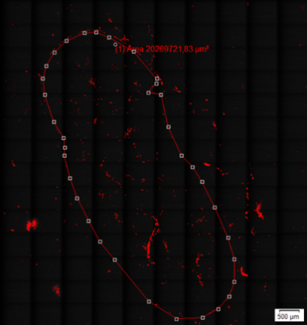
Picrosirius red kidney
Mann Whitney U Not significantly different

Slide 40
Picrosirius red liver
Not significantly different

Slide 41
Liver collagen
Biochemical collagen analysis

Slide 42
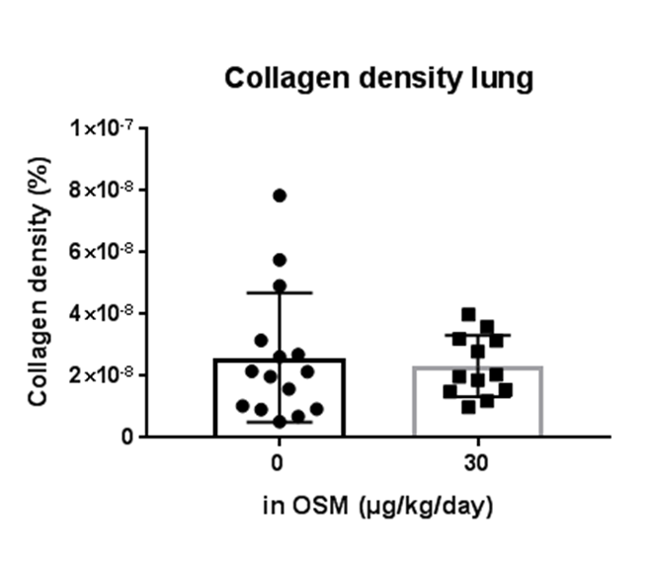
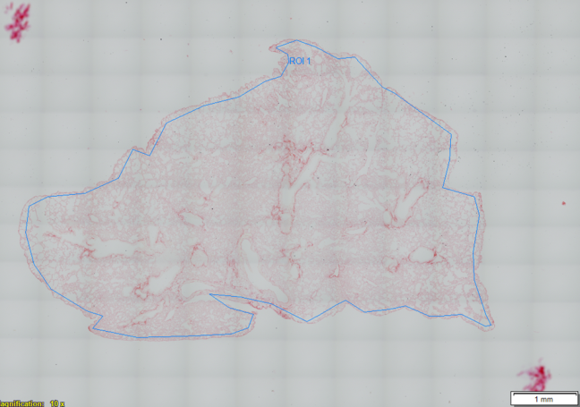
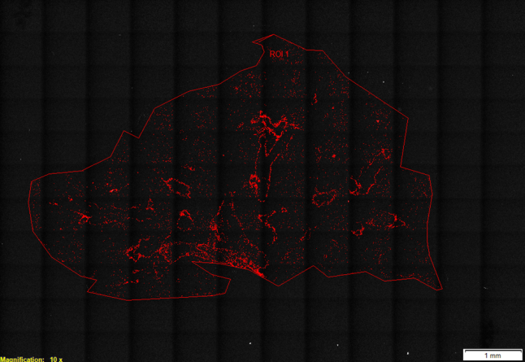
Picrosirius red lung
Mann Whitney U Not significantly different

Slide 43
Does OSM induce EndMT (transition form endothelial cell to mesenchymal cell)?
In vitro
CarTarDis

Slide 44
In vitro results
ET-1: 3h incubation
SNAI1: 6 hours incubation

Slide 45
In vitro results
10 day OSM stimulation
EGM2
Daily medium change
Unfortunately, not reproducible…

Slide 46
Does OSM induce EndMT (transition form endothelial cell to mesenchymal cell)?
In vivo
CarTarDis

Slide 47
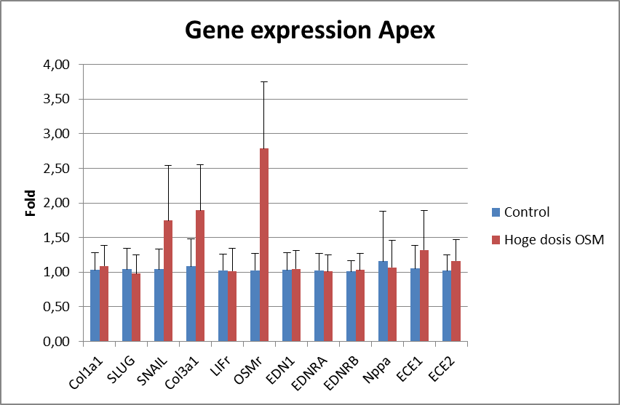
Gene expression apex
Snail t.test p=0.002
Col3a1 t.test Ln transformation p=0.001
Osmr t.test p<0.001

Slide 48
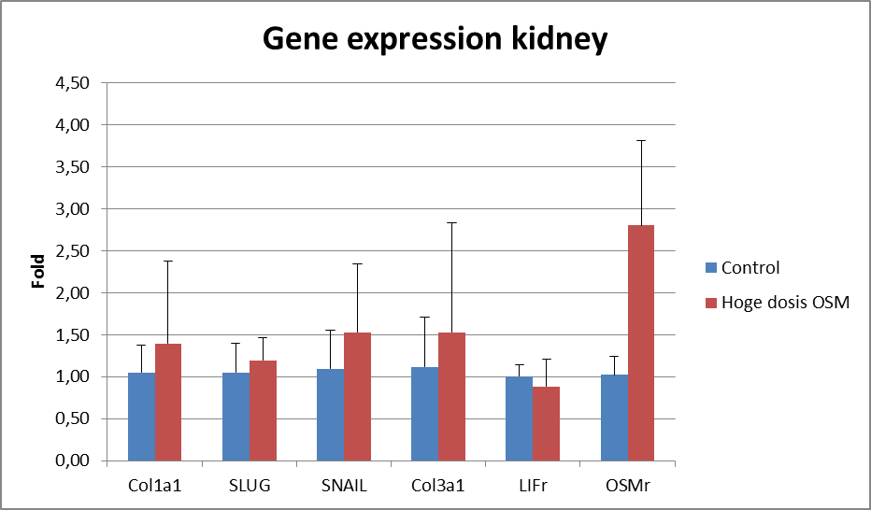
Gene expression kidney
Only Osmr is significantly increased

Slide 49
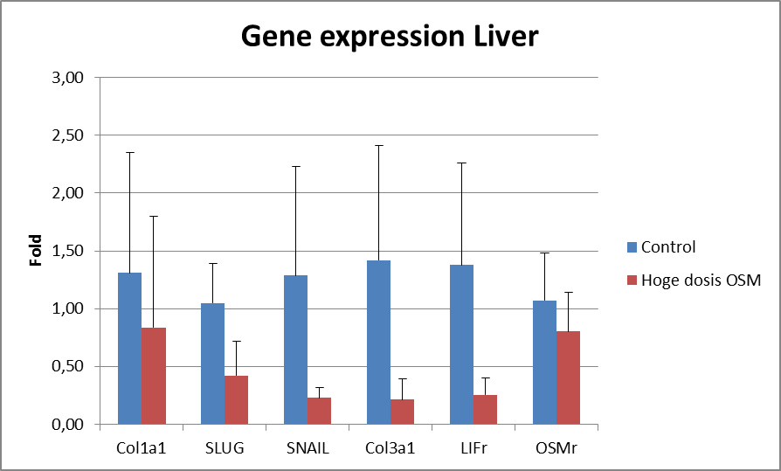
Gene expression liver
Slug, Snail, Col3a1 and Lifr are significantly decreased

Slide 50
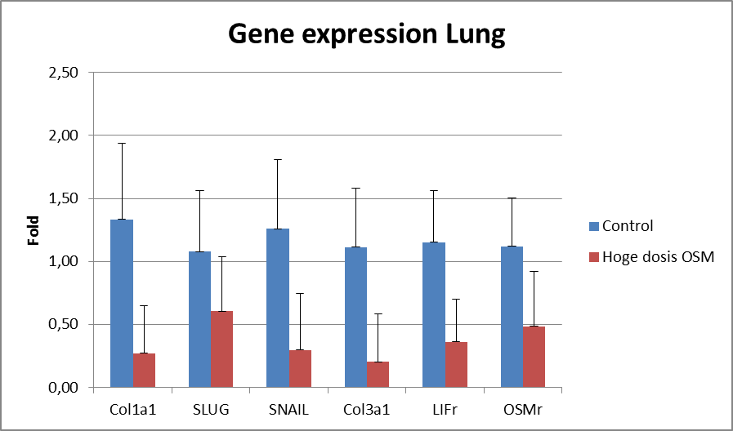
Gene expression lung
Col1a1, Slug, Snail, Col3a1, Lifr and Osmr are all significantly decreased

Slide 51
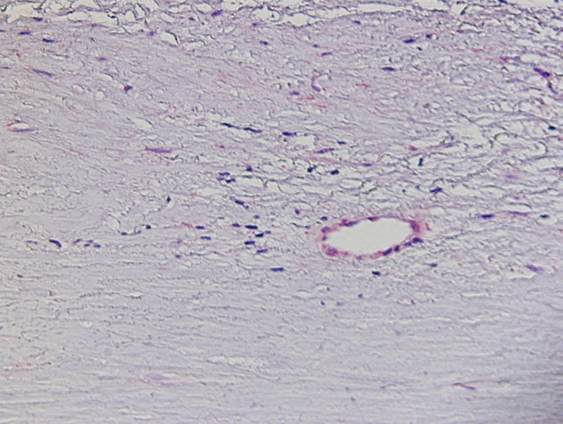
Slug in plaques

Slide 52
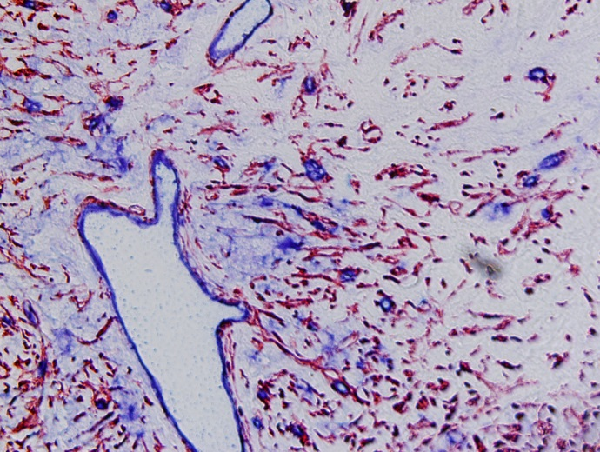
CD31 & aSMA

Slide 53
Other OSM data
CarTarDis

Slide 54
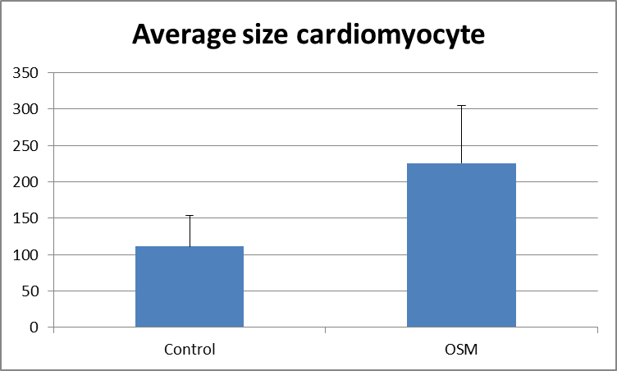
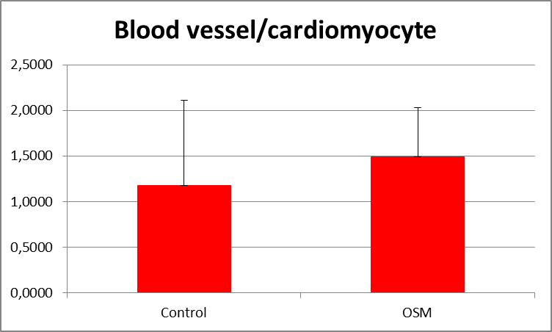
WGA Staining myocardium
Ttest p<0.001
Ttest on Ln transformed data
P=0.085

Slide 55
OSM increase blood pressure
CarTarDis

